Slide 1
INTRODUCTION
Università di Modena e Reggio Emilia

Slide 2
ANDROID TIMELINE
ANDROID OS VERSION
Name | Internal codename | Version number(s) | Initial stable release date | API level
Android 1.0 | N/A | 1.0 | September 23, 2008 | 1
Android 1.1 | Petit Four | 1.1 | February 9, 2009 | 2
Android Cupcake | Cupcake | 1.5 | April 27, 2009 | 3
Android Donut | Donut | 1.6 | September 15, 2009 | 4
Android Eclair | Eclair | 2.0 | October 27, 2009 | 5
 |  | 2.0.1 | December 3, 2009 | 6
 |  | 2.1 | January 11, 2010 | 7
Android Froyo | Froyo | 2.2 – 2.2.3 | May 20, 2010 | 8
Android Gingerbread | Gingerbread | 2.3 – 2.3.2 | December 6, 2010 | 9
 |  | 2.3.3 – 2.3.7 | February 9, 2011 | 10
Android Honeycomb | Honeycomb | 3.0 | February 22, 2011 | 11
 |  | 3.1 | May 10, 2011 | 12
 |  | 3.2 – 3.2.6 | July 15, 2011 | 13
Android Ice Cream Sandwich | Ice Cream Sandwich | 4.0 – 4.0.2 | October 18, 2011 | 14
 |  | 4.0.3 – 4.0.4 | December 16, 2011 | 15
Android Jelly Bean | Jelly Bean | 4.1 – 4.1.2 | July 9, 2012 | 16
 |  | 4.2 – 4.2.2 | November 13, 2012 | 17
 |  | 4.3 – 4.3.1 | July 24, 2013 | 18
Android KitKat | Key Lime Pie | 4.4 – 4.4.4 | October 31, 2013 | 19
 |  | 4.4W – 4.4W.2 | June 25, 2014 | 20
Android Lollipop | Lemon Meringue Pie | 5.0 – 5.0.2 | November 4, 2014 | 21
 |  | 5.1 – 5.1.1 | March 2, 2015 | 22
Android Marshmallow | Macadamia Nut Cookie | 6.0 – 6.0.1 | October 2, 2015 | 23
Android Nougat | New York Cheesecake | 7.0 | August 22, 2016 | 24
 |  | 7.1 – 7.1.2 | October 4, 2016 | 25
Android Oreo | Oatmeal Cookie | 8.0 | August 21, 2017 | 26
 |  | 8.1 | December 5, 2017 | 27
Android Pie |  | 9 | August 6, 2018 | 28
Android 10 | Quince Tart | 10 | September 3, 2019 | 29
Android 11 | Red Velvet Cake | 11 | September 8, 2020 | 30
Android 12 | Snow Cone | 12 | October 4, 2021 | 31
Android 12L | Un­known | Un­known | Q1 2022 | 32
2003: Android Inc. was founded
2005: Google bought Android Inc.
2008: first device with Android OS
https://en.wikipedia.org/wiki/Android_version_history

Slide 3
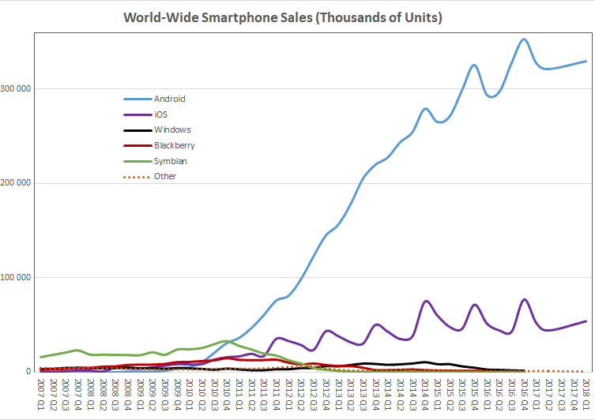
Android statistics
Year | Active users
2012 | 0.5 billion
2013 | 0.7 billion
2014 | 1 billion
2015 | 1.4 billion
2016 | 1.7 billion
2017 | 2 billion
2018 | 2.3 billion
2019 | 2.5 billion
2020 | 2.8 billion
https://www.businessofapps.com/data/android-statistics/
Over 3 millions android app in Google Play Store
https://en.wikipedia.org/wiki/Usage_share_of_operating_systems#/media/File:World_Wide_Smartphone_Sales.png

Slide 4
Why develop Android app?
MARKET SHARE
best-selling OS worldwide on smartphones and tablets
DEVICE COMPATIBILITY
FREE and OPEN-SOURCE SOTWARE
https://source.android.com/
PROGRAMMING LANGUAGE
You can use Java, Kotlin
SUPPORT
Large API

Slide 5
KEY FEATURES
Android is a OS based on Linux Kernel and open source software., is primarily developed for embedded device (smartphone, tablets, wearable, tv …).
Software packages on Android (APK format) are generally distributed through application stores (Google Play Store, …)
Android OS variant could be developed by everyone but need to implement key features to be easy-use from software developers.

Slide 6
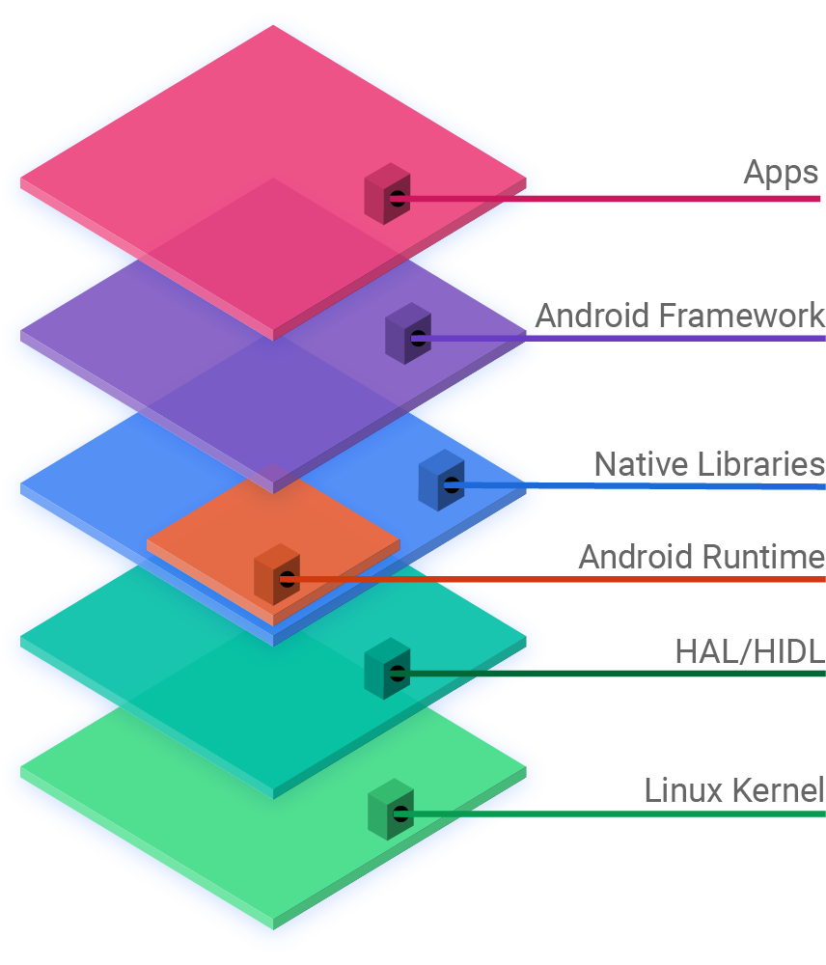
Android Architecture
ANDROID FRAMEWORK: When you develop android app you use Android Framework, which offer an interface for native languages libraries (Java, C++).
ANDROID RUNTIME: is the android “virtual machine”
Core Libraries is a set of classes which are used by SDK and included functionality near the android VM
HAL (Hardware Abstraction Layer): defines a standard interface for hardware vendors to implement
LINUX KERNEL: Android uses a version of the Linux kernel with a few special additions for a mobile embedded platform.
In Linux Kernel each application is binded to a single process

Slide 7
Java & Android
I write java code, so, ANDORID USE JAVA VIRTUAL MACHINE and I HAVE TO USE JDK?
No, Android devices don’t run .class and .jar files
To improve performance, use optimized formats.
FOR THIS REASON YOU HAVE TO USE ANDROID SDK, that inclue tools to convert java compiled code into android format

Slide 8

Android SDK
Android Software Development Kit contains the libraries and tools you need to develop Android apps
Android support:
Extra APIs that aren’t available in standard platform
SDK platform:
one for each Android version
SDK tools:
emulator, debugger, design tools…
Documentation:
access API documentation offline
Sample apps:
you can find pratical code to help you to use APIs
Android SDK

Slide 9
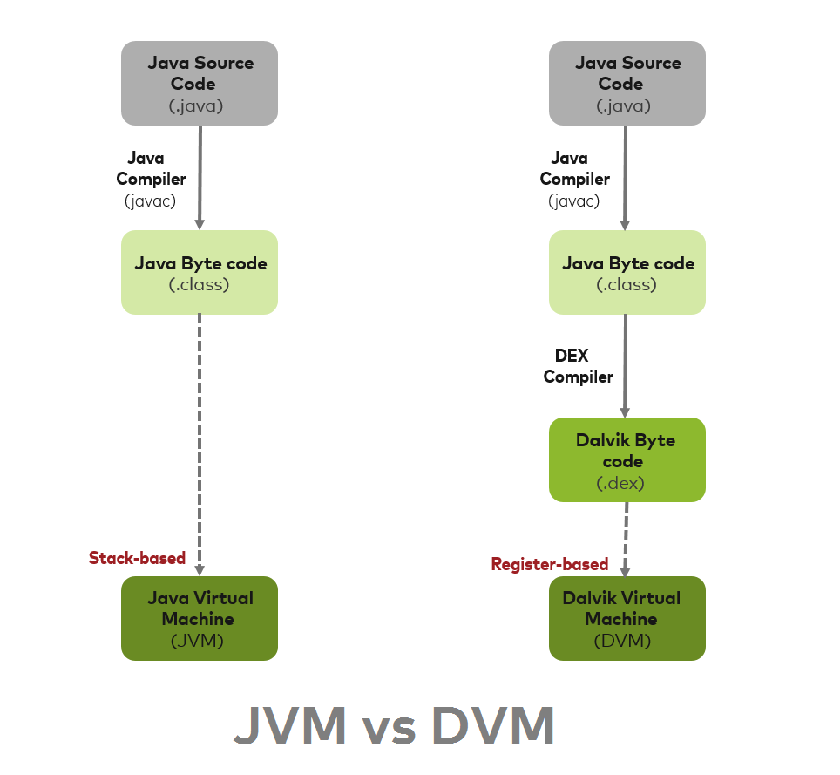
JVM vs Dalvik
Android doesn’t use JVM but use a special VM called DALVIK.
Android use DEX Compiler to transform Java Byte code in Dalvik Byte code (.dex)
Dalvik execute .dex

Slide 10
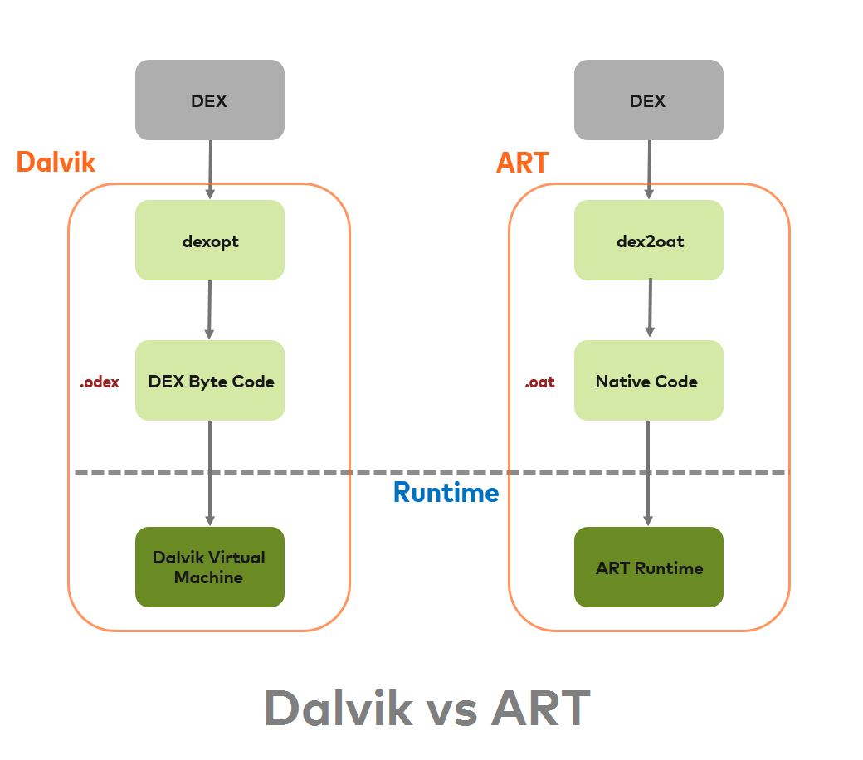
ART and DALVIK
https://source.android.com/devices/tech/dalvik?hl=en
Since Android 8.0 Dalvik has been replaced by ART (Android Run Time)

